Slide 1
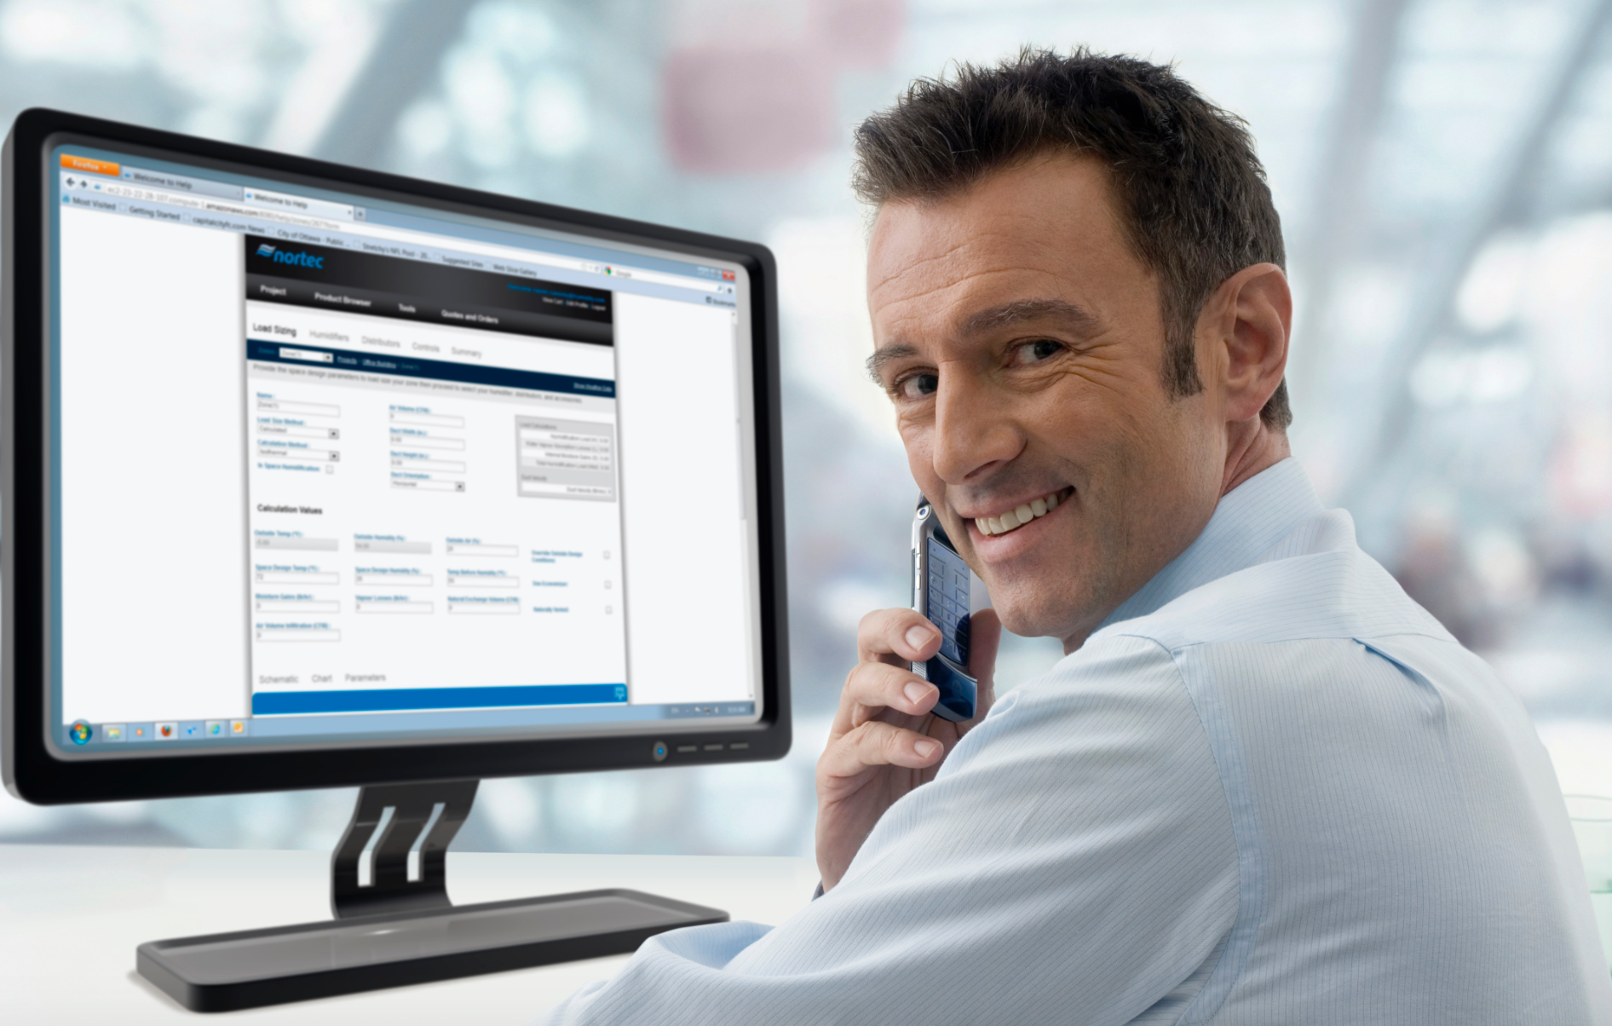
PeopleSoft ERP
FSCM 9.2 UPGRADE
Q2C Billing Changes

Slide 2

Agenda
Introductions
Objectives
Schedule
Fit Gap
Business Process Deltas between 9.1 and 9.2
Online Review / Offline Review
Confirm new functionality that should be explored for system design
Workflow
If applicable – Confirm whether AWE or Virtual Approver will be used
Interfaces
Retrofit / Eliminate
Customizations
Retrofit / Eliminate
Reports
Retrofit / Eliminate
Security
Batch Schedule
Discussion

Slide 3
Introductions
Name
Functional Area
Role

Slide 4
Schedule
Date | Time | Topic
10/04/2016 | 9 AM – 11 AM (CST) | Business Modeling Session 1: Receivables
10/05/2016 | 9 AM – 11 AM (CST) | Business Modeling Session 2: Receivables

Slide 5


PeopleSoft 9.2 Global Enhancements

Slide 6
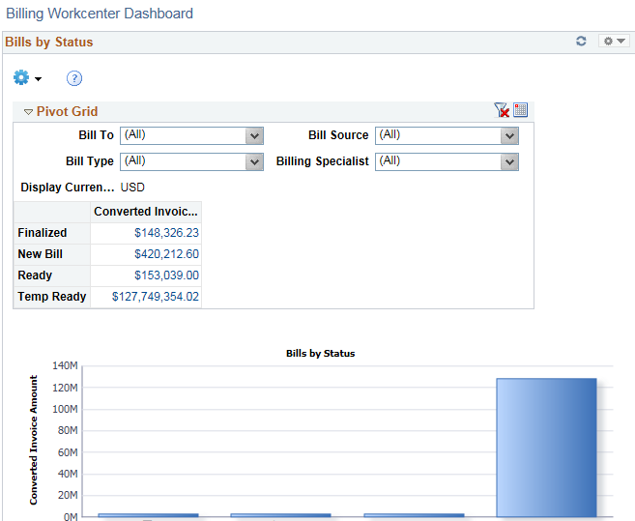
Pivot Grids
Pivots grids are based on PS Queries and can display the results in a grid format, a chart format, or both. Use the Pivot Grid Wizard to design how the page should appear.
Pivot grids can be added as pagelets (on a user’s Home page) and to the Queries tab in a WorkCenter.

Slide 7
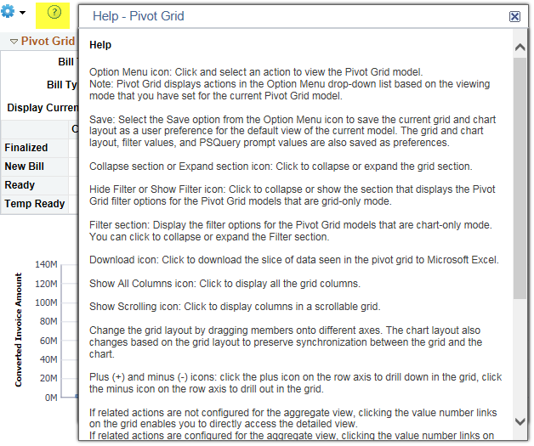
Embedded Help
Click the Embedded Help icon to open a secondary window with information about the page or section
Explains How to perform a specific task
Message appears in the Modal window which can be moved around the page

Slide 8
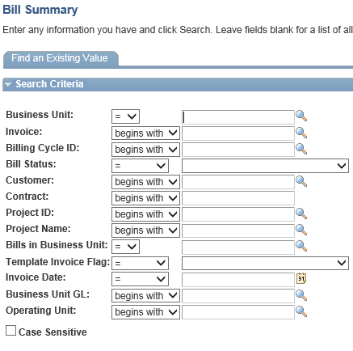
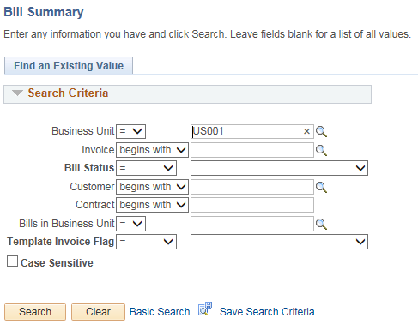
Alignment, Order and Positioning
Alignment
In PeopleSoft 9.1, all of the search and transaction fields were aligned to the left side of the page
In PeopleSoft 9.2, all of the search and transaction field labels will be right aligned to the fields
PeopleSoft 9.1 PeopleSoft 9.2

Slide 9
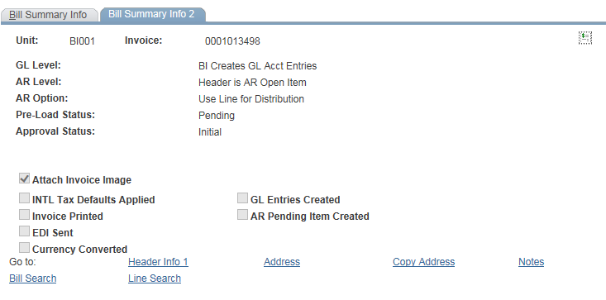
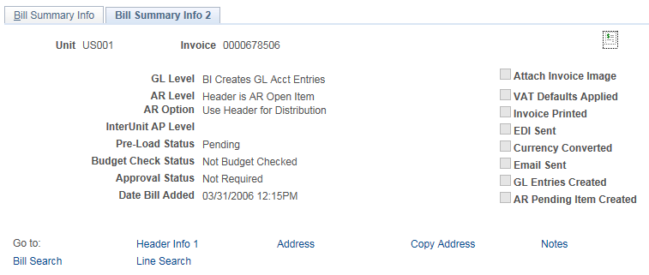
Alignment, Order and Positioning
Order and Positioning
Order and position of fields on the page may have changed
Function is not impacted or changes as a result
PeopleSoft 9.1 PeopleSoft 9.2

Slide 10

PeopleSoft 9.2 Billing Features

Slide 11
Billing 9.2 Highlights
Billing WorkCenter
Configurable work area in PeopleSoft Billing that helps manage business processes.
Billing Dashboard
Real-time access to important billing information to allow the users to quickly analyze data and take necessary actions to resolve issues such as Billing interface errors.
Billing Interface Mass Correction
Ability to correct interface errors for multiple billing lines using the Mass Update page.
Billing Interface ID Deletion
Entire Interface ID on bills can be deleted on Pending Transactions.
Configurable Bill Entry pages for Express Bills
Users can personalize the Express Bill Entry page.
ProForma Invoice
Ability to render an invoice from several new components.
Enhanced Credit and Rebill using the Approvals Workflow Framework.

Slide 12
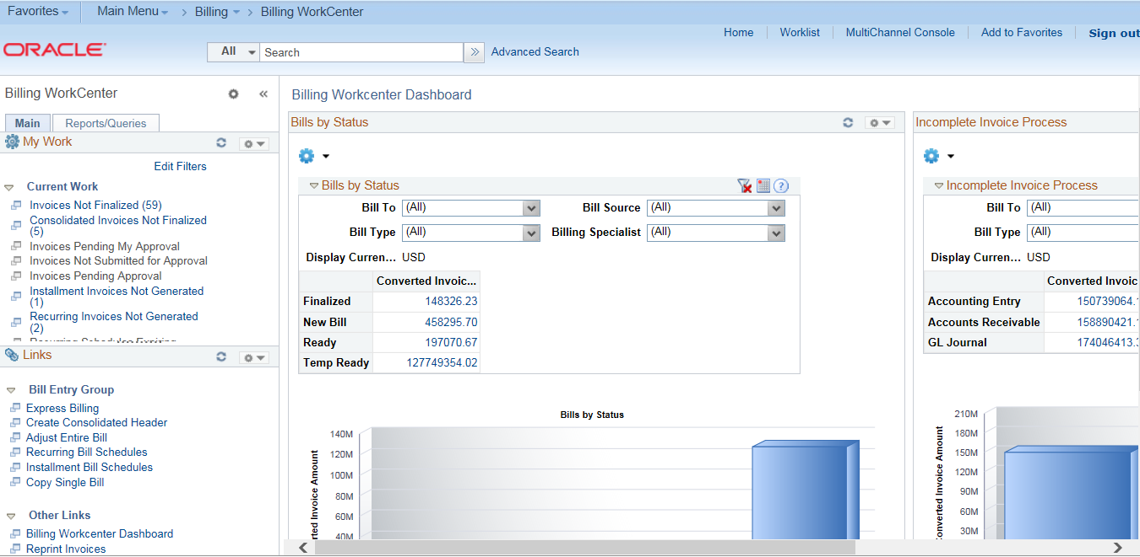
Business Processes – Deltas 9.1 vs 9.2
Billing WorkCenter – Streamlines billing tasks by providing power users a single place to perform a broad range of tasks without leaving the WorkCenter such as daily billing functions and exception alerts, monthly activities, and reporting.

Slide 13
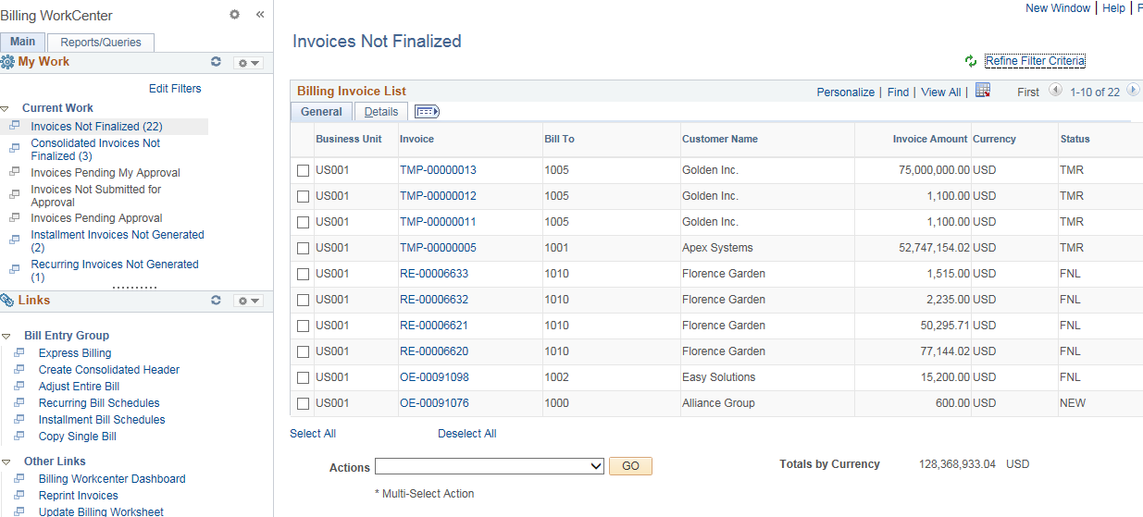
Business Processes – Deltas 9.1 vs 9.2
Billing WorkCenter - Continued

Slide 14
Business Processes – Deltas 9.1 vs 9.2
Billing WorkCenter - Continued
Eliminates tedious navigation
Personalize work tasks by adding/removing delivered alerts, links, reports
Personalize reports by adding your run control options for reports (Gear icon). Run control parameters are userid specific.
Link to external sites
Role based

Slide 15
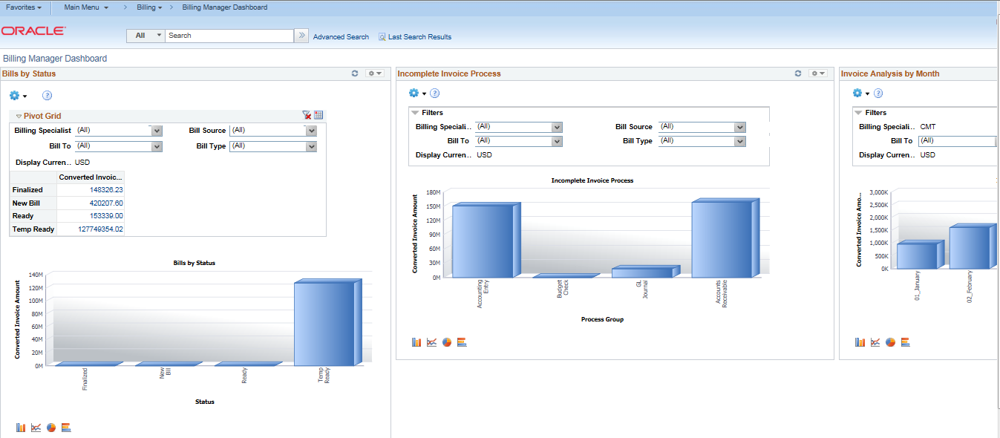
Business Processes – Deltas 9.1 vs 9.2
Billing Manager Dashboard – A manager facing dashboard that will primarily contain analytics and summary view of the billing functions in the organization.

Slide 16
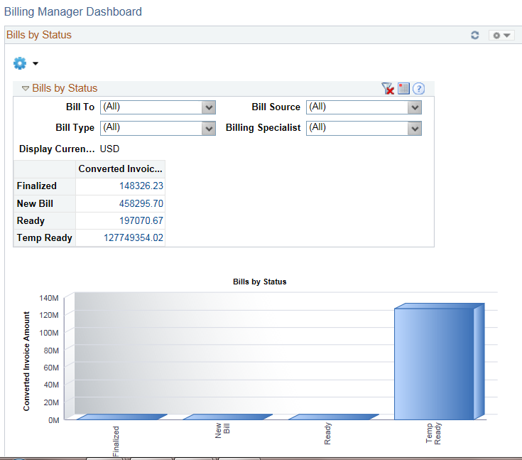
Business Processes – Deltas 9.1 vs 9.2
Billing Manager Dashboard (continued)

Slide 17
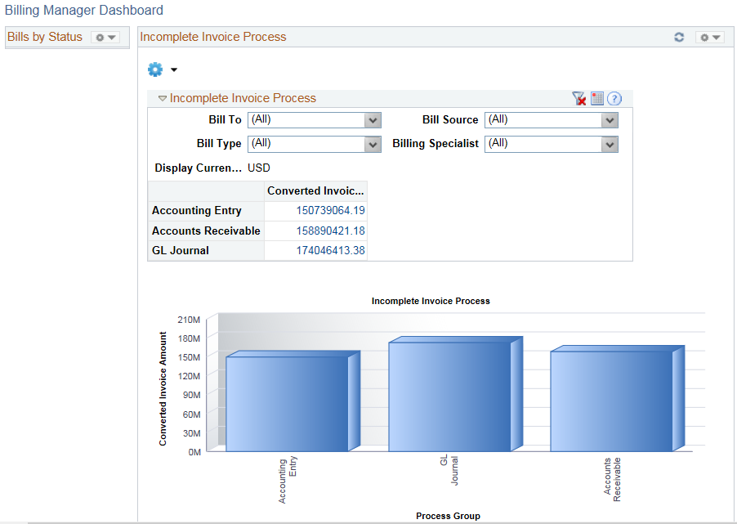
Business Processes – Deltas 9.1 vs 9.2
Billing Manager Dashboard (continued)

Slide 18
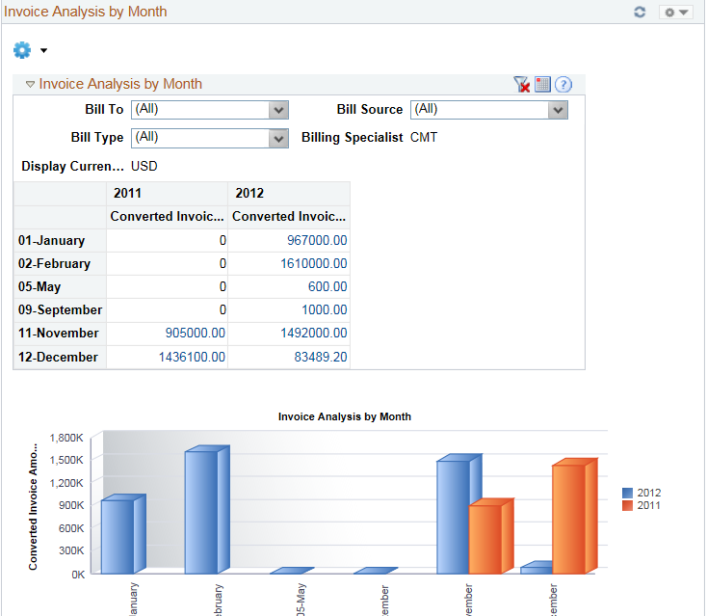
Business Processes – Deltas 9.1 vs 9.2
Billing Manager Dashboard (continued)

Slide 19
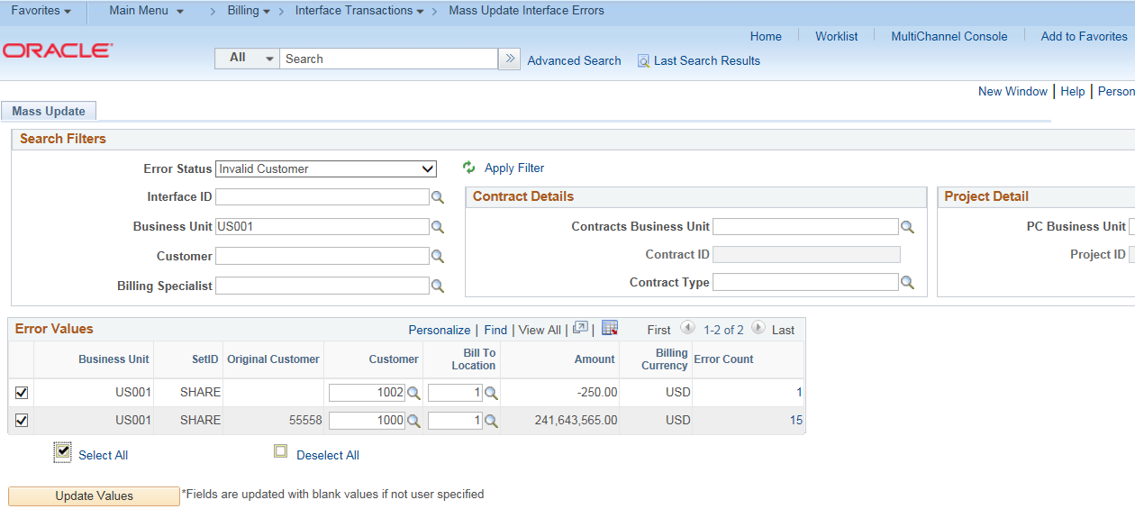
Business Processes – Deltas 9.1 vs 9.2
Billing Interface Mass Correction - Provides the ability for mass correction of specific interface errors for multiple billing lines. Billing Interface Mass Correction will streamline the effort that billing departments have to make to complete their invoicing tasks. This will allow billing users to make mass corrections by error codes on bills imported into PeopleSoft Billing.

Slide 20
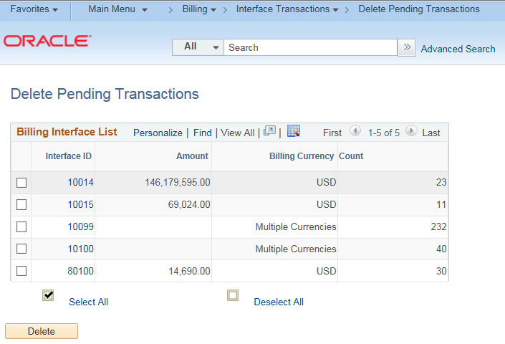
Business Processes – Deltas 9.1 vs 9.2
Billing Interface Deletion – Allows the deletion of entire Interface ID for bills. The interface IDs to be deleted must have interface lines with system source as either BBI or blank, and not an internal interface source (Contracts, Projects). The interface lines must not have a load status of ERR, UPD or DON.

Slide 21
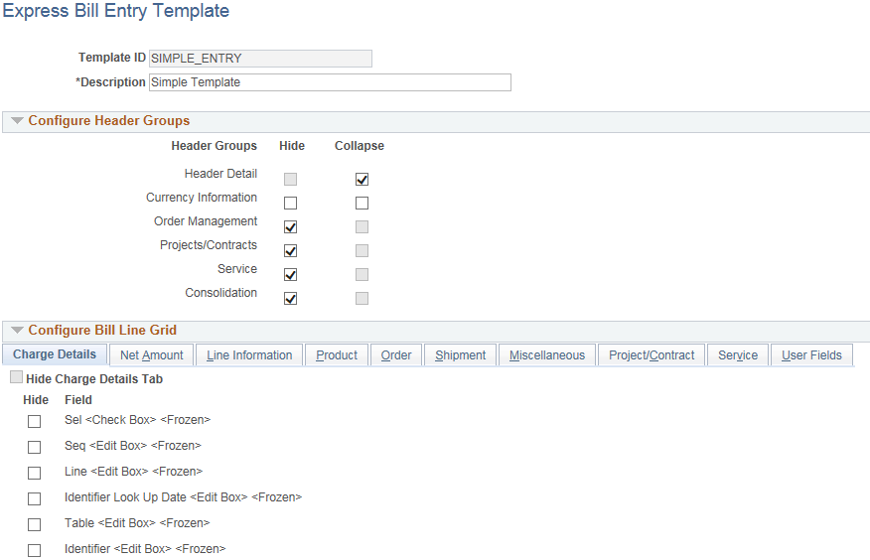
Business Processes – Deltas 9.1 vs 9.2
Bill Entry Pages - Allows the user to configure a billing entry page for Express Bills with only required fields through the use of bill entry templates. Users will be able to create bill entry templates and select exactly the fields they want on the entry page.

Slide 22
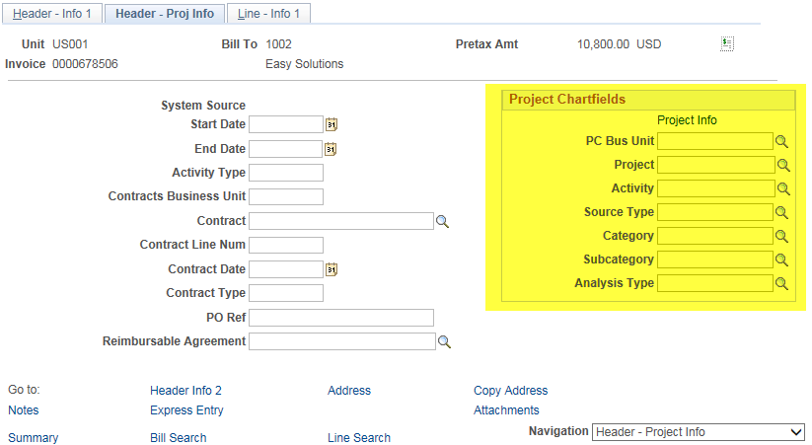
Business Processes – Deltas 9.1 vs 9.2
Billing Integration to Project Costing -
Enhanced the integration to projects by allowing manual bills entered in Billing to be interfaced to Project Costing.

Slide 23
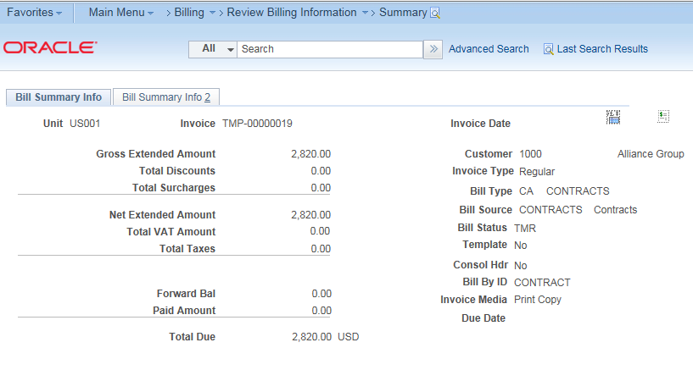
Business Processes – Deltas 9.1 vs 9.2
Pro forma Invoice - Provide users the ability to render a pro forma invoice online from the Standard Bill Entry, Express Bill Entry, Bill Summary, and Bill Inquiry components.
BI Publisher invoice format is required
The pro forma invoice can be printed without accessing the report manager
Access the Billing Installation page to enable online invoice rendering

Slide 24
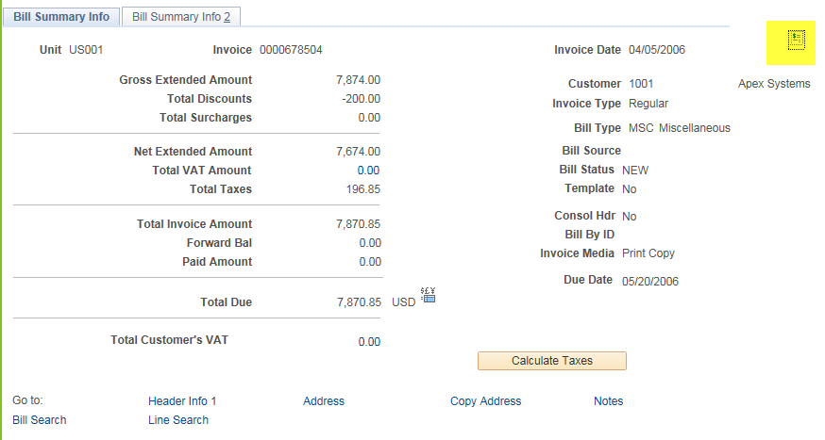
Business Processes – Deltas 9.1 vs 9.2
Pro forma Invoice - Continued

Slide 25
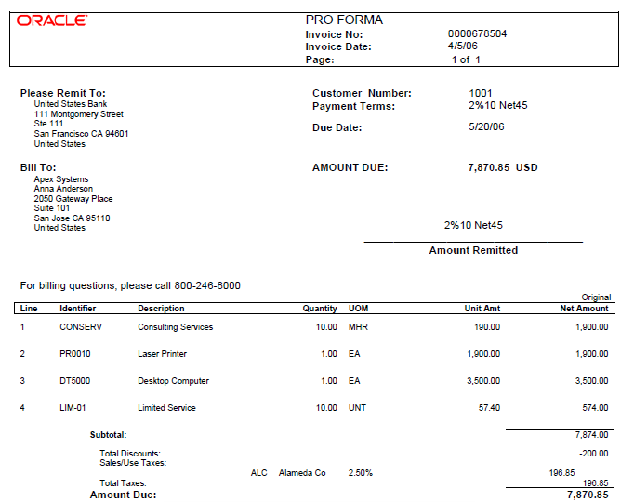
Business Processes – Deltas 9.1 vs 9.2
Pro forma Invoice - Continued

Slide 26
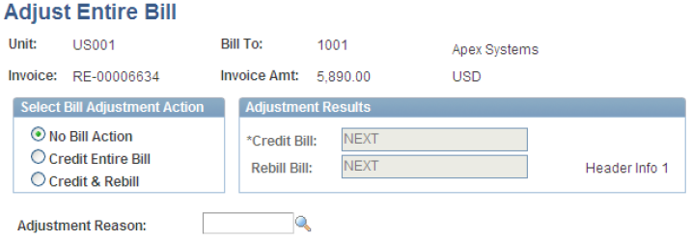
Business Processes – Deltas 9.1 vs 9.2
Enhanced Credit and Rebill
Introduced Approvals Workflow Framework for the approval of credits and re-bills created. This configurable approval process allows credits and re-bills to be sent to users for approval and ensures that users with proper authority approve these items.
Chartfield combination editing - Rebilled items now go through the ChartField combination editing process
A new adjustment reason is required for both header and line level adjustments

Slide 27
Customizations
Customizations | Description | Carry forward
Invoice Approval Submission Workbench & Process | New page created to search for invoices and select all of them or set of invoices and submit for approval. Modifications made to reorganize the invoice approval process by defining the invoice amount thresholds and approvers separately for each invoice approval group captured at contract level. Will also include credit memos. | Retrofit
Invoice Template/Print Envelope | Updated template per business specifications . New page created to store the Return Address displayed on an Invoice’s Print Envelope page. Display Note details (captured at the Bill Plan event level in Contracts & passed to Billing) on the Invoice. Display ACH Instructions on Invoice. Modified envelope page of print invoice to include “Attention” line in the customer address. Updated e-mail id on all templates and e-mail id from which the e-mails are sent to ARBilling@Optum.com. Populated the ship to contact correctly on proforma and invoice to eliminate the comma issue between first and last name. | Retrofit

Slide 28
Customizations
Customizations | Description | Carry forward
Invoice Template/Print Envelope (Continued) | Updated existing invoice template for project costing transactions to include the following: Project header and detail information relating to expenses, tasks, and resources at transaction level. Display the notes, purchase order and billing consultant (Project Manager) related to time worked and milestones achieved. Include fixed fee and TBP transactions. | Retrofit
Invoice Search | Include invoice date on the following billing search pages: Billing > Maintain Bills > Standard Billing Billing > Maintain Bills > Summary Billing > Review Billing Information > Details Billing > Review Billing Information > Summary Updated search results of invoice finalization error page so users can now view the Bill cycle id and Bill status in the search results. Enhance the search screens on the following pages to add bill cycle ID, project ID and project name Billing > Maintain Bills > Standard Billing Billing > Maintain Bills > Bill Summary Billing > Maintain Bills > Supporting Documentation Billing > Review billing information > Summary Billing > Review billing information > Details Billing > Review Billing Information > View Supporting Documentation | Retrofit

Slide 29
Customizations
Customizations | Description | Carry forward
Invoice E-Mail Notifications | Notifications sent for delivery failure of e-mailed invoices were modified to include the Customer and Contract ID’s in the subject line. | Retrofit
Customer PO Update | Update the customer PO number based on the processing billing business unit and invoice id combination. | Retrofit
Align Invoice Form w/Invoice Media | User can change the Invoice Media at the Billing address, which automatically populates Invoice form at the Billing header level. | Retrofit
Invoice Printing | New program developed to generate the Manifest file for the invoice delivery method print & send to Duncan. Updated code at the customer mapping integration to validate if any of the address fields have a carriage return & replace those with null value. Carriage return was causing reconciliation issues between Manifest File and Statement PDF’s sent to Duncan for printing. | Retrofit

Slide 30
Customizations
Customizations | Description | Carry forward
Invoice Due Dates | Due date on Invoice & Proforma PDF’s not matching the due date on Item List in Collections Workbench. Proforma/ Pre-Process and Finalization process did not take into account the Working Days/Non-Working Days when calculating the due dates in Billing module and the AR module did take these into account. Fix: Updates made to the following objects: Record PeopleCode - FUNCLIB_BI.PYMNT_TERMS_CD.FieldFormula AE SQL - BIIVC000 DUEDATE CALCBHTD.Do Select | Retrofit
Data Separation Optum 360/Optum General | Remove remit to and bank account configuration values from Bill Type New page created to configure remit to and bank account configuration at the Billing processing b.u. level for the ACH instructions on Invoices. New page created to store distinct logo by Billing processing business unit for inclusion on Invoices. | Retrofit
Invoice – Courtesy Copies | Modifications made to Billing and Contracts modules to support multiple recipients of invoices. Contacts with courtesy copies of Invoice. | Retrofit

Slide 31
Customizations
Customizations | Description | Carry forward
Project Based Billing Worksheet Approval | Custom process designed to send an e-mail notification to Project Managers to inform them that the Billing Worksheet is ready for approval. Updated code to only allow current project manager to view/approve worksheets. Fixed effective dated code logic to prevent wrong project manager in billing worksheet. PeopleCode has been modified to restrict the proforma process from picking up the approved billing worksheets every time the process runs. Users can view the Pre-tax invoice amount and total invoice amount details when the billing worksheet is sent to managers for approval. Allow the users to submit an invoice for approval having more than one operating unit. Added new search filter on Bill Cycle ID to enable business to review only billing worksheets related to their business segment. Updated Billing Worksheet e-mail notification with bill cycle ID description. New draft invoice template created to attach to e-mail notifications to Project Managers. | Retrofit
Manual Billing | Modifications made to populate Revenue and AR GL strings based on the product ID selected in billing (Line Info1). Business has the flexibility of selecting the product and the product description which will be populated automatically. | Retrofit

Slide 32
Customizations
Customizations | Description | Carry forward
Invoice Date | Invoice date should reflect the date on which the invoice was finalized not the data provided during CABI process. New application engine program created to make the date Null which then changes the date to current date in the finalization Job. | Retrofit
Optum International On-Boarding/MC | Updated AR open balance load program to handle multi-currency codes. Updated custom ACH Instructions and Remit to Addresses on Invoices custom pages with new currency code, address 3 line, country and other fields. Invoice formatting changes made for international/multi-currency. Created a new interface with Vertex for VAT and GST taxes Updated Open AR and Customer conversion processing for tax impacts. Changes made for integration with UHGPS (printing services). | Retrofit
Sales Tax Accounting Entries | Modified the accounting engine program to create tax accounting entries based on product tax GL BU and OU. | Retrofit

Slide 33
Customizations
Customizations | Description | Carry forward
Invoice Delivery Method | Introduced the new invoice delivery method called Manual Print for not sending invoices to customers. Suppressed invoice delivery method e-mail notification and Federal Highway file (govt. based invoices). | Retrofit

Slide 34
Inbound Interfaces
Interface | Description | Carry forward
EHR (Executive Health Resources) | Invoiced activity files sent to PS ERP on an ad hoc basis | Retrofit

Slide 35
Outbound Interfaces
Interface | Description | Carry forward
Vertex | US Sales & Use Tax, VAT and GST (International) calculation process | Retrofit
Shutterfly (formerly Duncan) | Invoice files for customers having delivery method = print sent to printing services | Retrofit

Slide 36
Thank you
Contact information
Fiona McIntosh
#860-702-9930
Fiona_McIntosh@optum.com

